Slide 1

Report of the Regional Committee of United Nations Global Geospatial Information Management for Africa (UN-GGIM: Africa) on its Eleventh Meeting (Document Reference No. E/ECA/COE/44/13) Samuel K. Annim Director, African Centre for Statistics [Sunday, 29 March 2026]

Slide 2
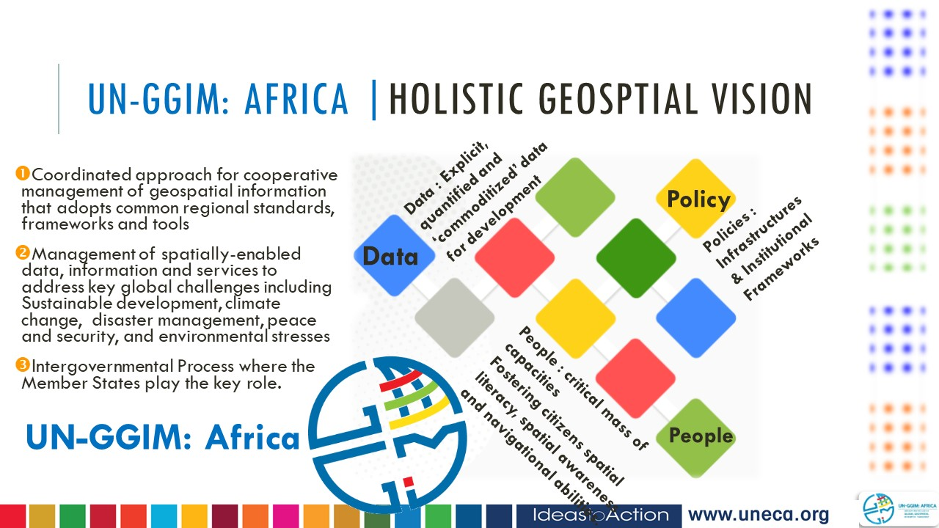

Context
Binding Commitments: Integration, Beyond Emerging Data and Governmental
Involvement

Slide 3




Focus Areas of the Meeting
1.
2.
Strengthening regional and global geospatial partnerships to amplify Africa’s voice and share its experiences globally.
Implementing the Integrated Geospatial Information Framework
Cross-Cutting Issues: Capacity Building and Governmental Involvement
3.
4.
Embedding geospatial data in national development planning.
Promoting the ethical and innovative use of emerging geospatial data and AI technologies

Slide 4
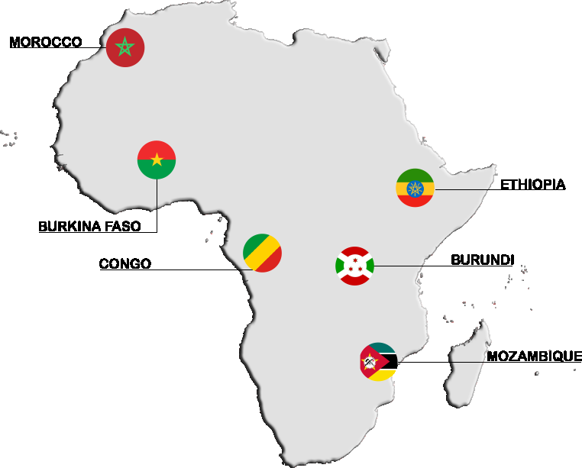
UN-GGIM: Africa | Progress, Challenges, Capacity Building and Sustainability
Progress in Geospatial Ecosystems
Africa has made significant progress in building geospatial ecosystems through regional collaboration and policy harmonization.
Challenges and Gaps
Many countries still face outdated systems, fragmented governance, and financial constraints that hinder geospatial adoption.
Capacity Building Initiatives
Investments in training programs and e-learning have equipped thousands with skills in mapping, cartography and spatial data analysis.
Need for Sustained Support
Sustained investment, stronger coordination, and political support are essential to advance geospatial frameworks regionally.

Slide 5
Activities of the Working Groups
Integrated Geospatial Information Framework
The African Geodetic Reference Frame
Aim: Support implementation of the
framework across Africa
Key discussions:
Terms of reference
Objectives
Activities
Working methods
Aim: Strengthen Africa’s geodetic infrastructure
Key discussions:
Set the terms of reference
Elected leadership
Area of cooperation
Integration of Geospatial and Statistical Information
Land Administration and Management
Aim: Identify solutions for sustainable land management in Africa
Key discussions:
First Online meeting
Invitation for broad participation
To ensure broad representation from all African subregions
Aim: Strengthen the integration of geospatial and statistical information in Africa
Key discussions:
Agreed on objectives
Reviewed country-level integration efforts
Discussed shared challenges

Slide 6
Activities of the Working Groups
Private Sector and Academia
Global Geodetic Observing System
Need for greater participation of the private sector in geospatial governance
Proposal to establish a formal academic network
Universities can translate technical standards into practical training and applications
Africa has limited geodetic observation infrastructure
Only one major observation site in South Africa
Opportunity to expand geodetic infrastructure across the continent
UN Global Geospatial Information Management (UN-GGIM)
Overview of structure and global work programme of United Nations Global Geospatial Information Management
Reports to the United Nations Economic and Social Council
Concerns raised about staff shortages affecting the Committee’s work

Slide 7
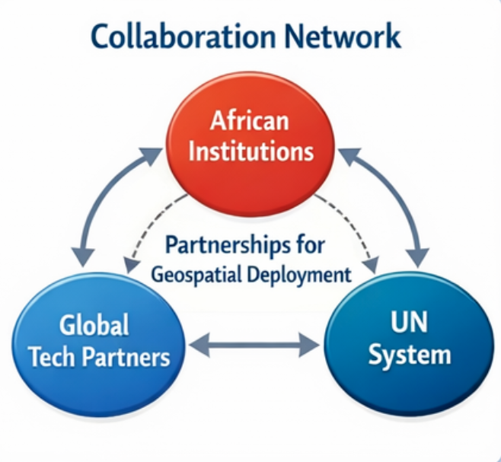
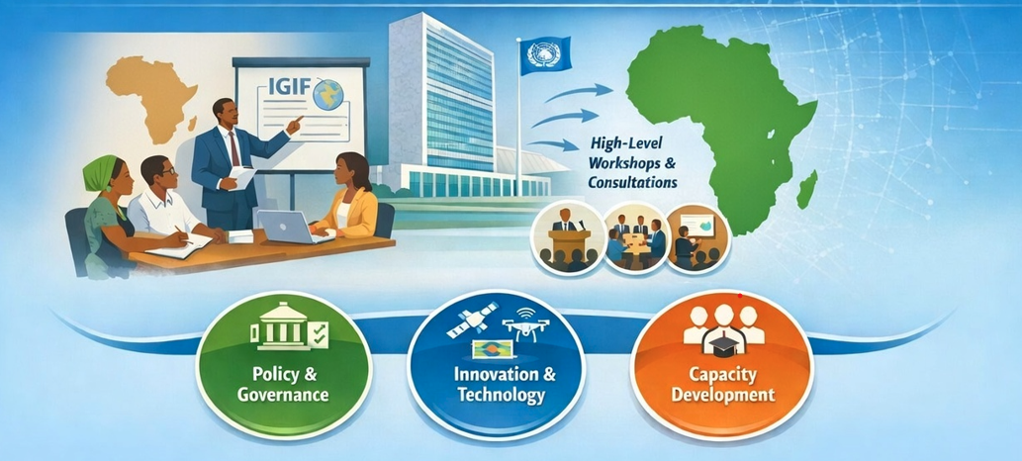
Strategic Partnerships and Resources
United Nations Integrated Geospatial Information Framework, GIS for Good, Satellite Data for Development, High-Resolution Earth Observation and Open Geospatial Standards

Slide 8

UN-GGIM: Africa | Key Issues
1. Africa’s geospatial governance is advancing but faces persistent structural gaps
The report underscores a decade of progress in frameworks, policies, and capacity-building, yet also highlights chronic challenges: limited funding, fragmented structures, weak governance, and low implementation of resolutions. The need for robust geospatial governance mechanisms and coherent national arrangements is re‑emphasized throughout the document.
2. Integrated Geospatial Information Framework (UN-IGIF) is Africa’s priority, but
implementation is slow
Most countries remain at early or intermediate stages of UN-IGIF adoption. Several recommendations call for accelerating national action plans, expanding technical support, and aligning IGIF with national development and statistical systems.
3. Need for a statutory geospatial information committee at continental level
Participants emphasized the importance of establishing a dedicated statutory body under ECA/AU to consolidate continental leadership and convene ministerial or Heads-of-State engagement.

Slide 9
UN-GGIM: Africa | Strategic Recommendations for the Conference of Ministers (COM 2026)
A. Establish a continental statutory mechanism for overarching geospatial governance
Recommendation for COM Decision: Mandate the creation of an African Geospatial Information Council (AGIC) or similar statutory body under AU/ECA to coordinate continental geospatial governance, convene ministerial dialogues annually, oversee implementation of IGIF, and strengthen Africa’s voice in global UN‑GGIM processes.
Why: The report repeatedly highlights fragmentation, inconsistent implementation, and the need for continental leadership authority.
B. Call for member States to accelerate national IGIF implementation and report annually
Recommendation for COM Decision: Urge all Member States to finalize IGIF national action plans by 2027 and submit annual implementation reports to the Regional Committee, with support from the UN Global Geospatial Knowledge and Innovation Centre.
Why: IGIF is central to the continent’s geospatial modernization, yet progress is slow; COM endorsement will unlock political commitment and resource prioritization.
C. Endorse sustainable financing mechanisms for national and regional geospatial programmes
Recommendation for COM Decision: Request Member States to allocate dedicated geospatial budget lines and encourage use of innovative financing (PPPs, digital public infrastructure funds, etc.).
Why: Funding gaps undermine infrastructure, data quality, and staff retention; ministers’ support is essential.

Slide 10
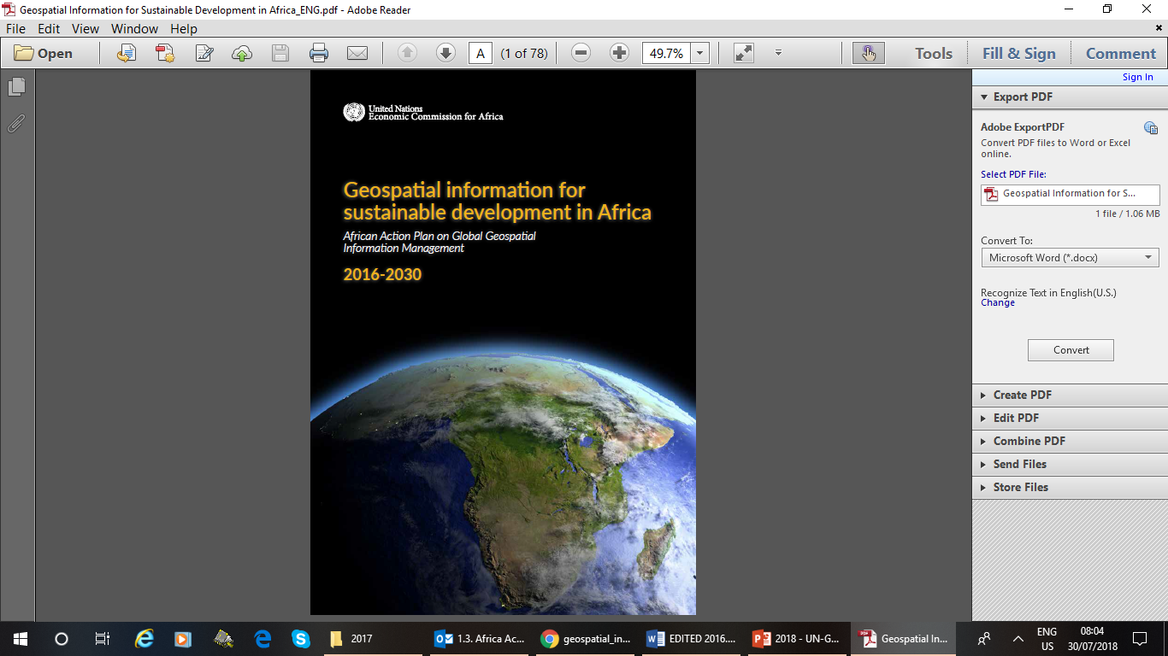
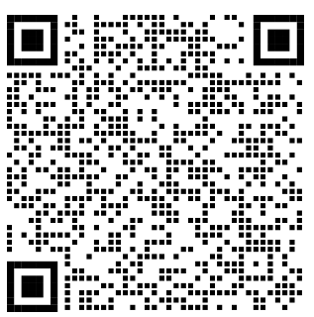
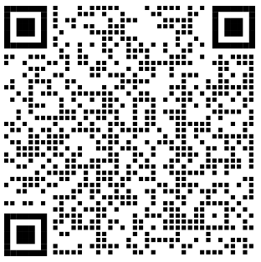
Know More…
The African Action Plan
English | www.uneca.org/sites/default/files/PublicationFiles/un-ggim_-_geospatial_information_for_sustainable_development_in_africa-20171115.pdf
French | www.uneca.org/sites/default/files/PublicationFiles/geospatial_information_for_sustainable_development_in_africa_fre-20171115.pdf

